Slide 1
CELL BOUNDARIES
0
How Cells Regulate What Goes In and Out

Slide 2
CELL WALLS
0
CELL WALL -PROTECT & SUPPORT
  PLANTS (CELLULOSE)
  FUNGI (CHITIN)
  ALMOST ALL BACTERIA(POLYSAC)
  SOME PROTISTS

Slide 3
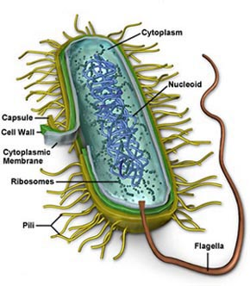
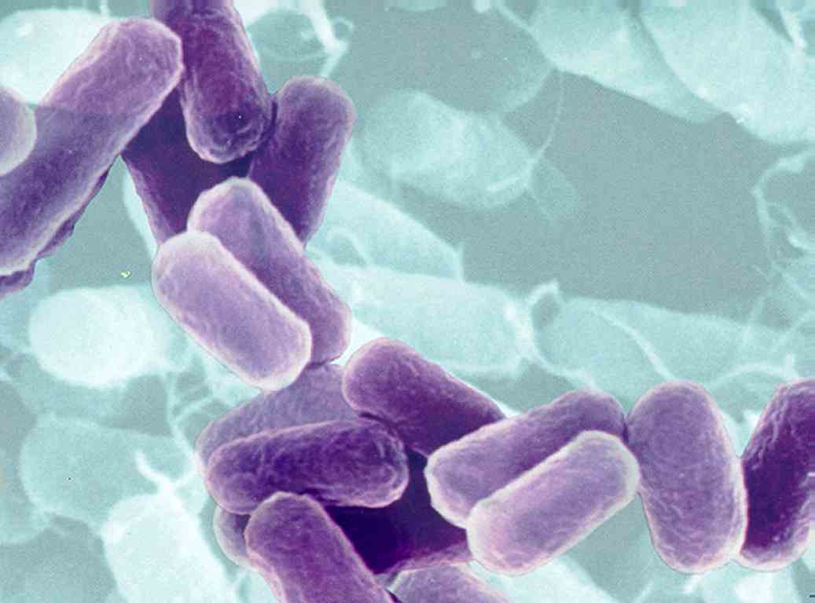
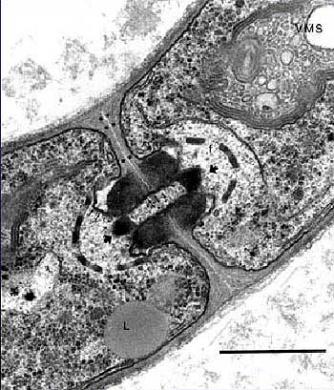
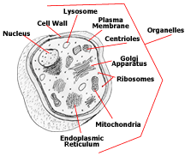
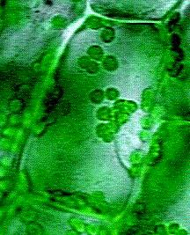
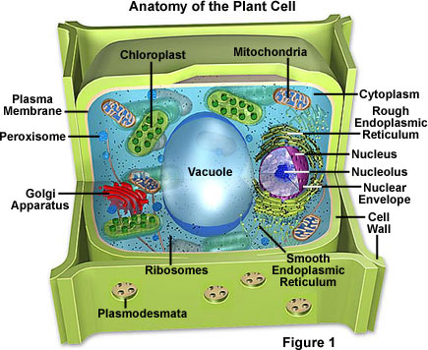

Slide 4
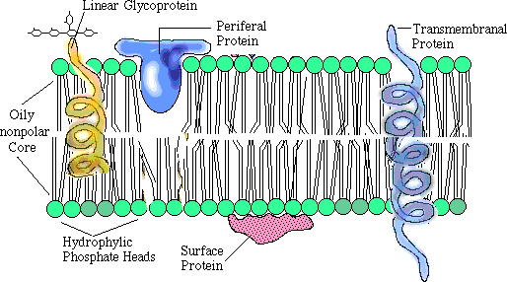
The Plasma Membrane
0
Phospholipid Bilayer
Found in all cells
Controls access to cell interior

Slide 5
STRUCTURE OF P.M.
0
PROTEIN/LIPID BILAYER
LIPIDS CONTAIN
  2 FATTY ACID CHAINS
  A PHOSPHATE HEAD
  CALLED PHOSPHOLIPIDS
PHOSPHATE HEAD IS POLAR
FATTY ACID TAILS ARE NONPOLAR

Slide 6
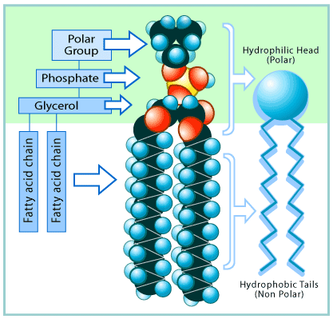
0

Slide 7
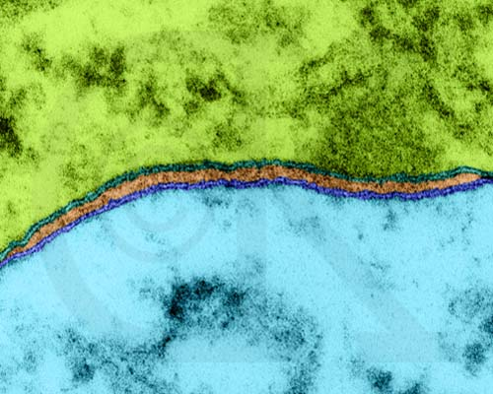
0

Slide 8
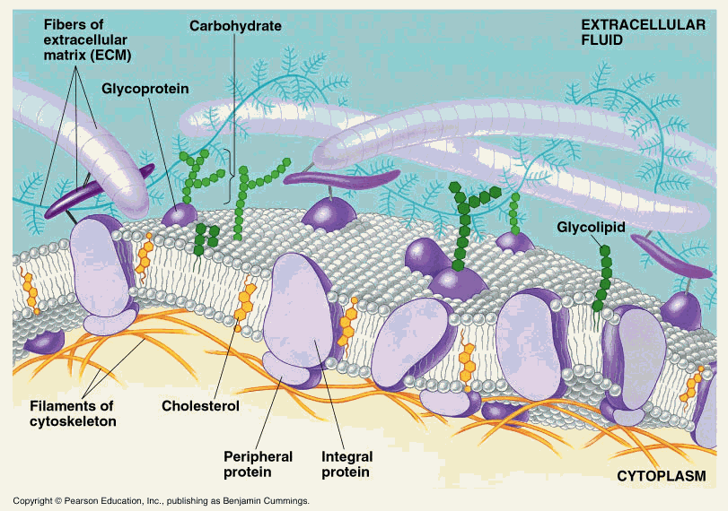
0

Slide 9
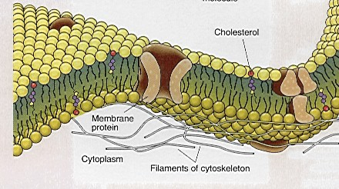
FLUID MOSAIC MODEL
0
PERTAINS TO
  PLASMA MEMBRANE
  ORGANELLE MEMBRANES
TYPES OF PROTEINS AND LIPIDS VARY
ARRANGEMENT OF PROTEINS AND LIPIDS VARY
CHOLESTEROL GIVES ANIMAL MEMBRANES STABILITY

Slide 10
HOMEOSTASIS
0
CELLS MUST REACT TO CHANGES IN THEIR ENVIRONMENT QUICKLY-- OR DIE!
Membrane structure allows fast reaction while maintaining homeostasis.

Slide 11
SELECTIVE PERMEABILITY
0
ALLOWS SOME MATERIALS TO PASS THROUGH WHILE REJECTING OTHERS
  SIZE OF MOLECULE
  CHEMICAL RECOGNITION
DIFFERENCES IN SELECTIVITY FOR DIFFERENT CELLS
Permeability and Cell Membrane

Slide 12
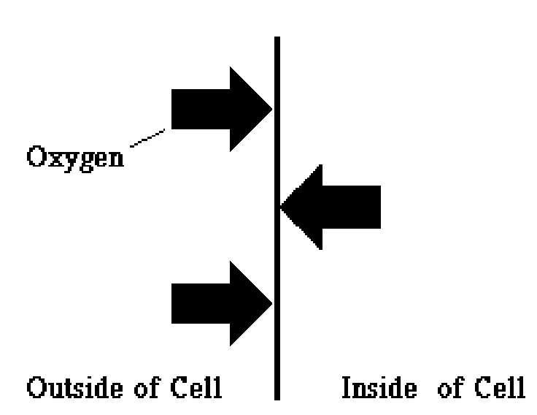
Diffusion
0
Brownian Motion
Browninan Motion
Movement from high concentration to low concentration
Dynamic Equilibrium

Slide 13
CONCENTRATION GRADIENT
0
THE DIFFERENCE IN CONCENTRATION ACROSS A SPACE OR MEMBRANE.
HIGH CONCENTRATION GRADIENT
  GREAT DIFFERENCE
LOW CONCENTRATION GRADIENT
  SMALL DIFFERENCE

Slide 14
OSMOSIS
0
THE DIFFUSION OF WATER MOLECULES, THROUGH A MEMBRANE FROM AN AREA OF HIGH CONCENTRATION OF WATER TO AN AREA OF LOW CONCENTRATION OF WATER.

Slide 15
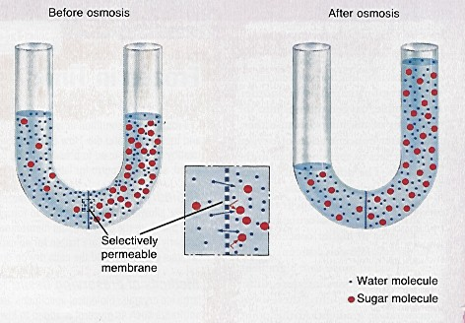
0
Cells are immersed in a watery environment
Leads to movement of water across cell membranes

Slide 16
SOLUTION CONCENTRATIONS
Hypotonic
Hypertonic
Isotonic

Slide 17
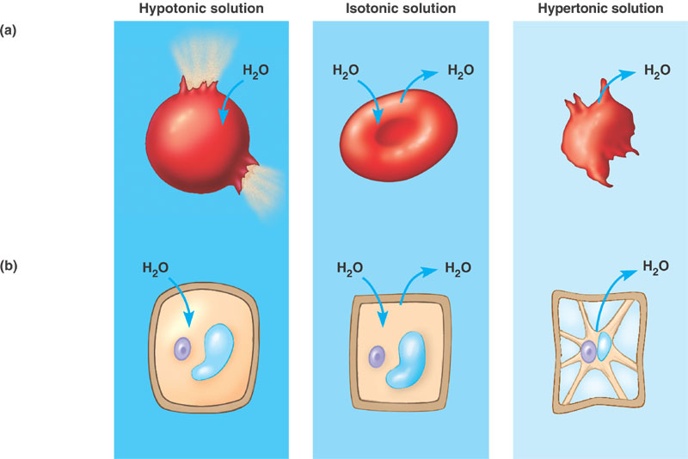
SOLUTION CONCENTRATIONS
0

Slide 18
PASSIVE TRANSPORT
(NO ENERGY)
0
OSMOSIS-WATER
DIFFUSION
  LIPIDS
  LIPID SOLUBLE SUBSTANCES
FACILITATED DIFFUSION
  TRANSPORT PROTEINS
  CONTROL SELECTIVE PERMEABILITY
  INCREASE RATE OF TRANSPORT
  ie SUGARS AND AMINO ACIDS

Slide 19
ACTIVE TRANSPORT
(ENERGY)
0
TRANSPORT OF MOLECULES AGAINST THE CONCENTRATION GRADIENT FROM LOW CONCENTRATION TO HIGH CONCENTRATION
REQUIRES ENERGY FROM THE CELL
  PLANT ROOTS, GLYCOGEN IN LIVER

Slide 20
TRANSPORT PROTEINS
0
CHANNEL PROTEINS: FACILITATED DIFFUSION
CARRIER PROTEINS: ACTIVE TRANSPORT

Slide 21
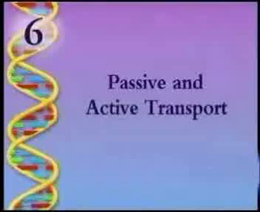

Slide 22
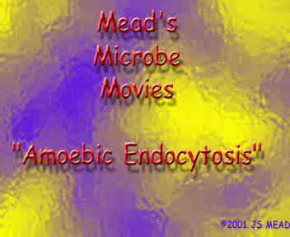
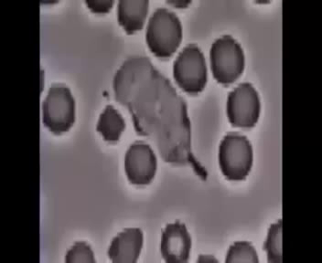
ENDOCYTOSIS
(ENERGY)
0
SURROUNDING LARGE PARTICLES AND TAKING THEM INTO THE CELL, CREATING A VACUOLE
  PHAGOCYTOSIS-LARGE PARTICLES
  PINOCYTOSIS-SMALL PARTICLES

Slide 23
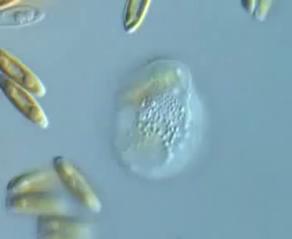
EXOCYTOSIS
(ENERGY)
0
REVERSE PROCESS
  EXPEL WASTES
  SECRETE SUBSTANCES
    HORMONES

